Slide 1
Cell Decomposition and Roadmap Method in Robot Motion Planning
Team Member: Weijia Ye, Zifei Yu

Slide 2
OUTLINE
Cell Decomposition: Trapezodial Decomposition
Roadmap Method: Visibility Graph Method

Slide 3
Cell Decomposition

Slide 4
Cell Decomposition
Create map with obstacles, start location and goal location.
Determine the type of obstacle points. The points can be classified to six types, including left, right, up, down, right-hollow and left-hollow.
According to each point type, create cells with current sweep location and dynamic matrices with information of current upper and lower bounds.
Finally, pick middle point of bounds between cells. Additional points are picked in order to help us to find the best way with limited amount of points.

Slide 5
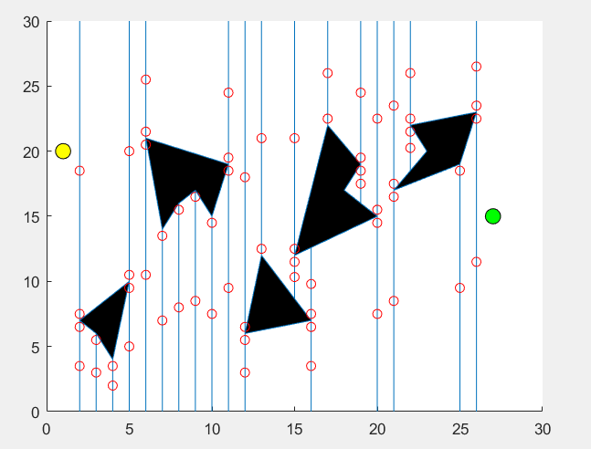
Create Cells

Slide 6
Roadmap Method

Slide 7
Roadmap Method
Visibility roadmap are used in path planning in the following way:
Because based on the result of cell decomposition, we have no need to create the new polygonal obstacles, and all the cell can be used as new obstacle’s node.
Node are connected if they are already connected by each cell and the line segment joining them is in free space
Not only is there a path on this roadmap, but it is the shortest path
If we include the start and goal nodes, they are automatically connected
Algorithms for constructing them can be efficient

Slide 8
Avoid Obstacles
Using the method of vector cross product to determine which cell’s line segment cross the obstacle’s boundaries. If two line segments are cross, then, the cells of line segment not show in fig.2
X3
X2
X1

Slide 9
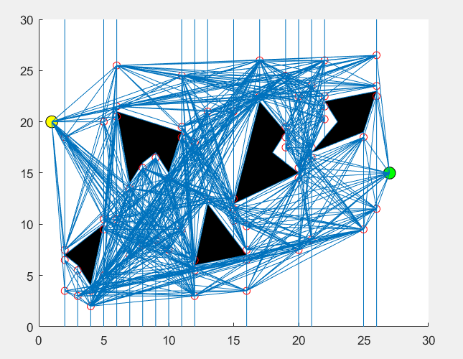
Avoid Obstacle

Slide 10
Best path
Algorithm
List all the possible routes with no more than 5 path points, choose routes according to the length of the route.

Slide 11
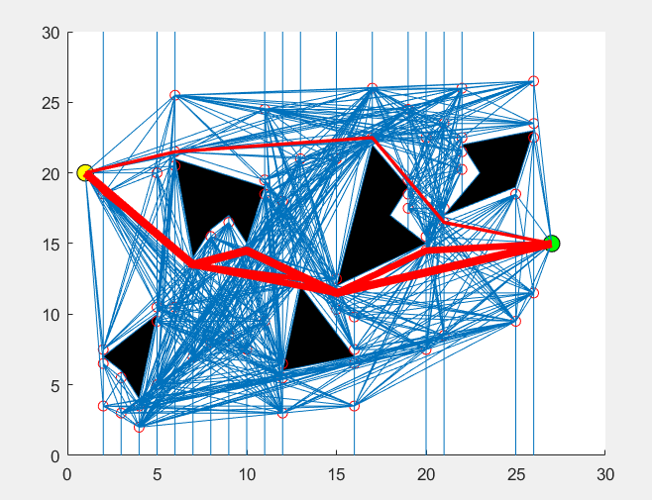
Find the best path

Slide 12
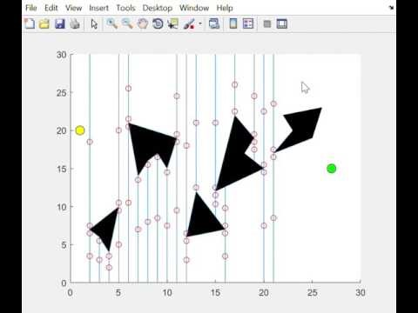
Show Video
Create cell

Slide 13
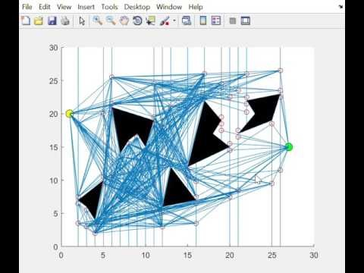
Avoid obstacle

Slide 14
THANK YOU

